Slide 1
ELECKART MARKET MIX MODELING
Subham Roy

Slide 2
Agenda
Understanding Data and Business Objectives
Data Preparation EDA
KPI
Models
Generated Suggestion

Slide 3
Understanding Data and Business Objectives
Electronic products are the focus of the Ontario, Canada-based e-commerce company ElecKart. In the past year, they had invested a substantial sum of money in marketing. On occasion, they had also provided high-profile promotions (like the Big Billion Day). The following year's marketing budget, which will cover advertising, internet campaigns, and price and promotion plans, is set to be developed. In order to increase the revenue response, the CFO believes that the marketing expenditures of the previous 12 months were insufficiently effective and that they can either reduce the budget or reallocate it between marketing channels.
Goals- to develop market mix models for the following three product subcategories: gaming accessories, home audio, and camera accessories. Every week, the models for each of the aforementioned subcategories must be constructed.

Slide 4
Understanding Data and Business Objectives
Understanding Data The following files were used in the analysis: Consumer Electronics: This is the base data collection that includes order information. Product List: The dataset containing each product's frequency and % contribution The dataset that provides details on the allocation of investment expenditures for the specified period is known as Media Investment. Monthly NPS Score: This information provides the stock index and monthly NPS score for the specified period. The datasets Ontario-2015 and Ontario-2016 provide information about the climate for the specified time period in their respective years.

Slide 5
Understanding Data and Business Objectives
These are the columns that make up the data:
Order Date: FSN ID: Each SKU's unique identity THE DATE OF ORDER PLACEMENT
ORDER ID: EACH ORDER'S UNIQUE IDENTIFICATION NUMBER
ORDER ITEM ID: IF YOU PLACE TWO DIFFERENT PRODUCTS UNDER THE SAME ORDER, IT WILL CREATE TWO DIFFERENT ORDER IDS Orders are tracked by the order
Tem ID; item IDs are under the same order ID.Gross Merchandise Value or Revenue, or GMV
UNITS: THE NUMBER OF UNITS OF THE PARTICULAR PRODUCT SOLD
ORDER PAYMENT TYPE: CASH ON DELIVERY OR PREPAID
SLA: The average number of days needed to deliver the product
CUST ID: UNIQUE PRODUCT IDENTIFICATION FOR CUSTOMERS Product
Procurement SLA: The average time required to acquire the product;
MRP

Slide 6
Data Preparation
The data set (in this case, consumer electronics) must be cleaned, input, new features created, etc. before any models can be built on it. The strategy we used to accomplish this is as follows:
Verify the dataset for any type inconsistencies and make the necessary corrections.
If there are any duplicate records, remove them.
Either drop the columns or impute the NULL values to get rid of them.
Rows with product mrp = 0 are removed.
Eliminate rows where gmv = 0.
Correct the custid, pincode, and fsnid values that are negative.
Take only those records that fall within the specified time period. (from July 2015 to June 2016).Rows with GMV > MRP*UNITS should be removed because they are not
Using the frequency of each value, look for any outliers in the dataset and eliminate them.
To convert monthly data to weekly data, create a new column to hold the weeknumber.

Slide 7
Data Preparation
Limit the SLA for product procurement to 30 days.
Remove the negative values and cap the Sla at 15.
To do analysis, divide the data into three data sets, one for each of the three product subcategories (gaming, home audio, and camera accessories).
Transform the monthly data into weekly data.
To build a final data frame for each product that will be used for EDA and used to choose KPIs, combine all three data frames with the remaining files.

Slide 8
Data Preparation
While preparing the data, the following was noted:
While preparing the data, the following was noted:
Duplicate records are eliminated using the order_id field.
We can determine that "deliverybdays" and "deliverycdays" have 79% values when we compute the column-wise NULL values. Since NULL values also have negative values, we can remove these columns.
We now examine the SLA and product procurement SLA columns to look for outliers in the dataset. The number of days it takes to deliver the package cannot be capped with a specific number. We have maintained the value at 15 in our model.
The dataset is then split up into three dataframes, one for each product subcategory that requires analysis.

Slide 9


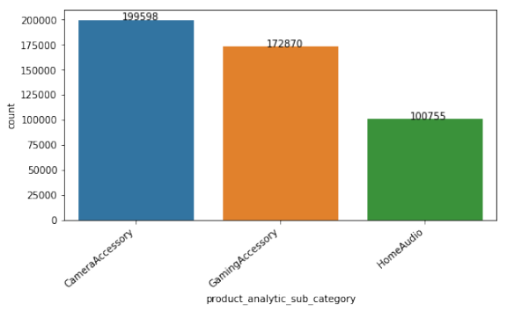
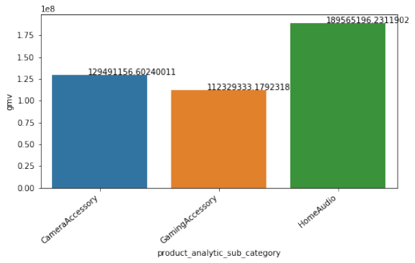
EDA
Highest revenue is generated by Home Audios data set.
Volume of orders generated by Camera Accessories data set

Slide 10
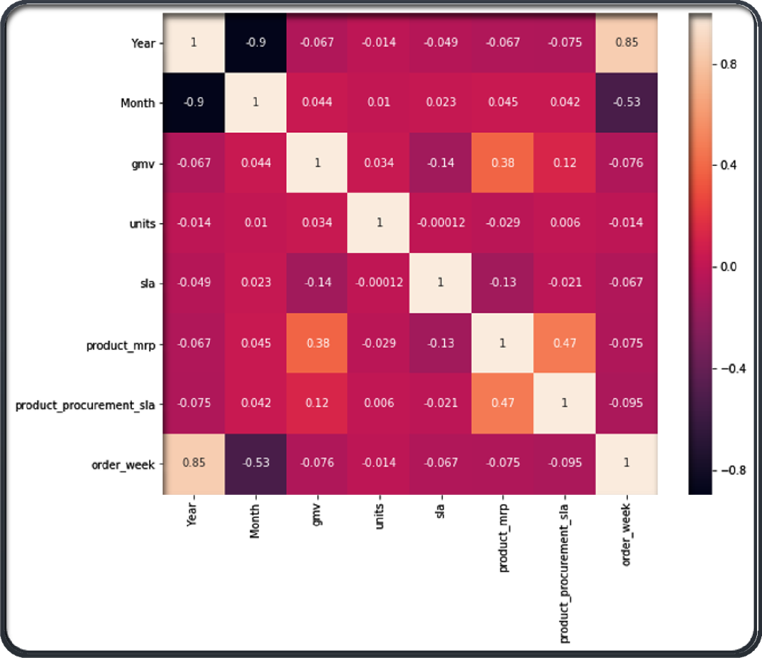
EDA
Month and D Year, Month and Order, and Product MRP and GMV and Product MRP and Product Procurement SLA have a strong and moderate correlation, respectively.

Slide 11
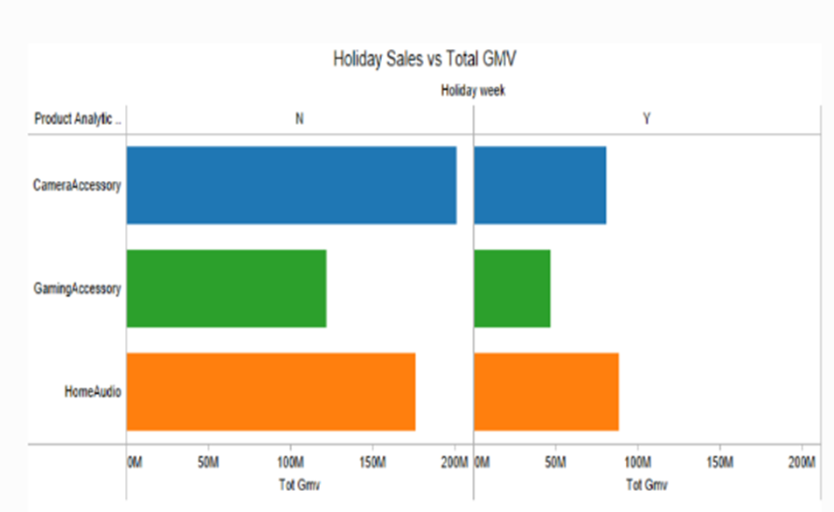
EDA
Sales increased during holidays and maximum revenue is generated by camera accessories.

Slide 12
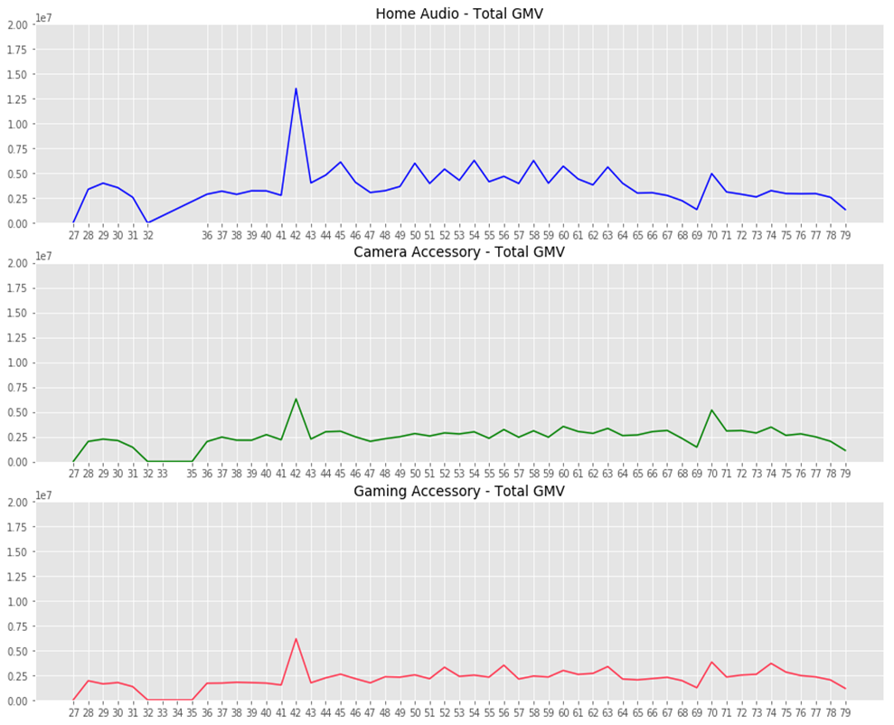
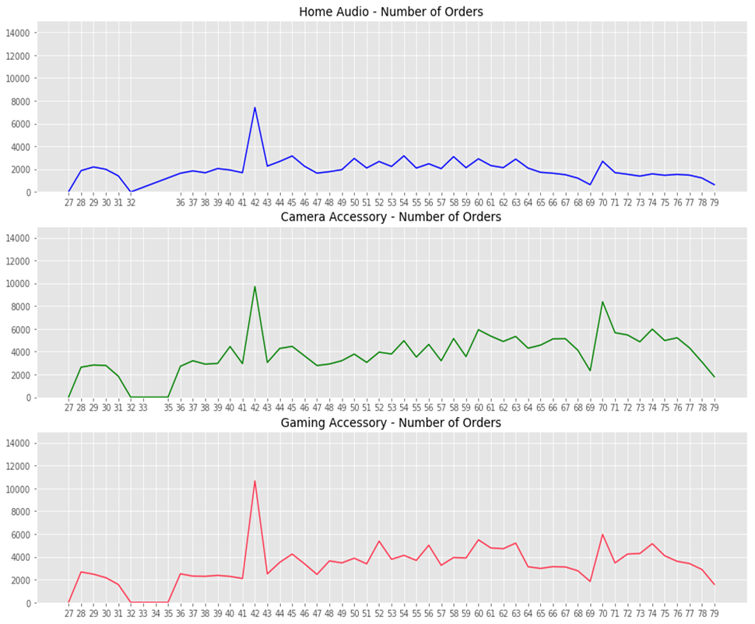
EDA
Week 42- Highest number of orders
Highest Revenue- Game accessories Highest count- Home Audios

Slide 13
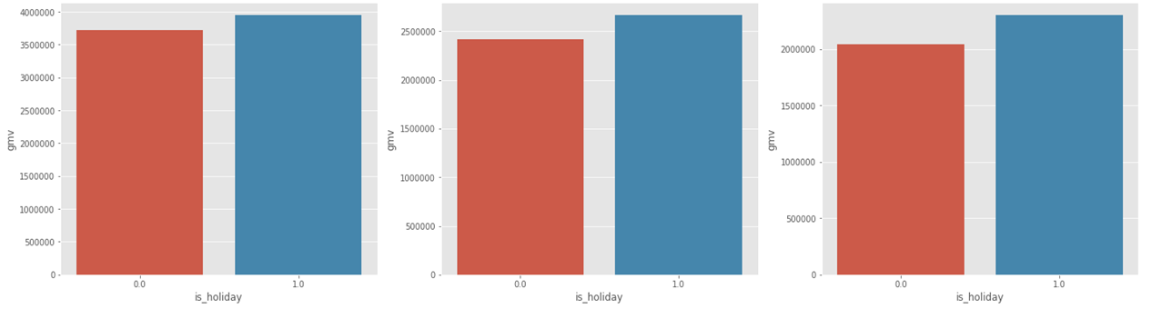
EDA
Home Camera Gaming
Revenue generated in both holidays and non-holidays

Slide 14
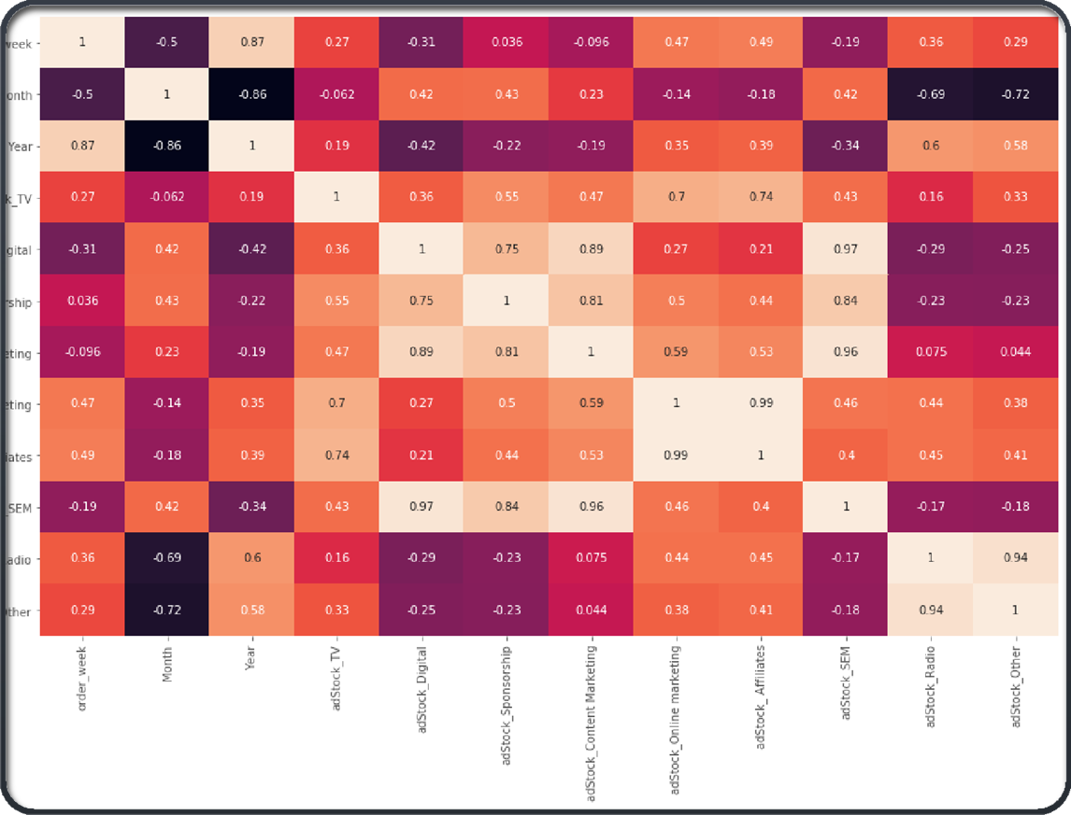
EDA
High Correlation
ORDER WEEK & MONTH, YEAR & MONTH, ORDER WEEK & YEAR
ADSTOCK_AFFILIATES and ADSTOCK_ONLINE MARKETING
ADSTOCK_OTHER AND ADSTOCK RADIO
ADSTOCK CONTENT MARKETING AND ADSTOCK SEM
ADSTOCK TV AND ADSTOCK AFFILIATES.

Slide 15
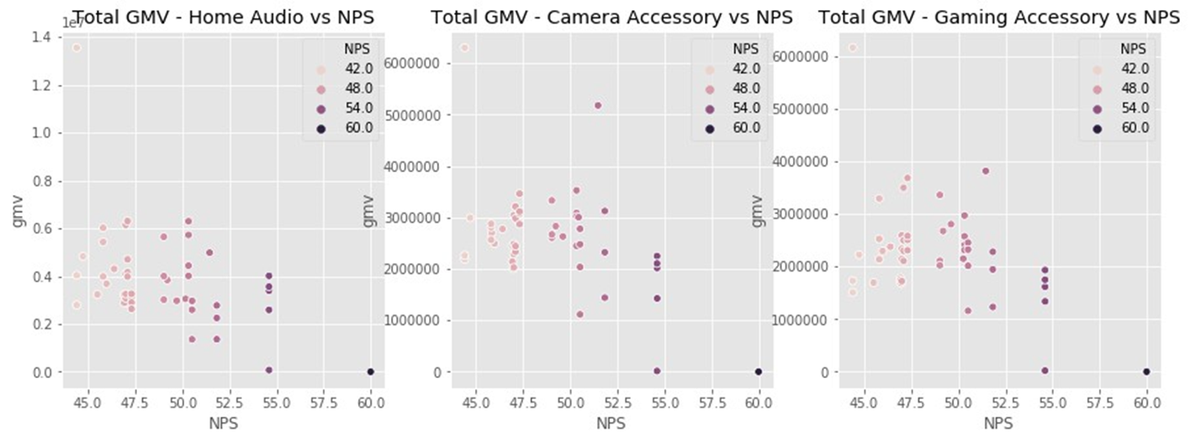
EDA
Negative correlations
In Sub categories : decrease in GMV and increase in NPS

Slide 16
SELECTED KPIS
Affiliates of Adstock
Adstock radio
Adstock Consumer Electronics Adstock Semi
Week of payment, discounted selling price
Total GMV
Indicator of payment modality and product premiumness
Special week, holiday week

Slide 17
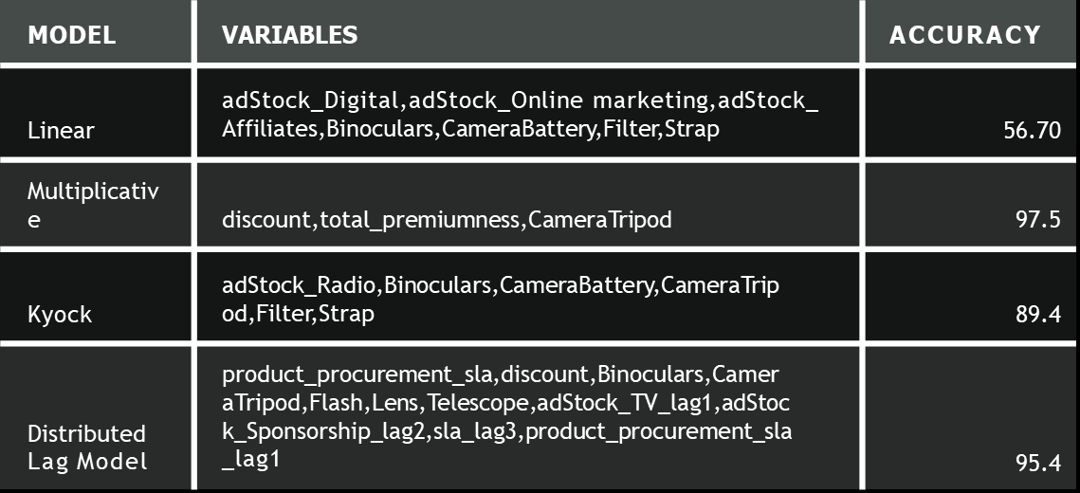
CAMERA ACCESSORY MODELS

Slide 18
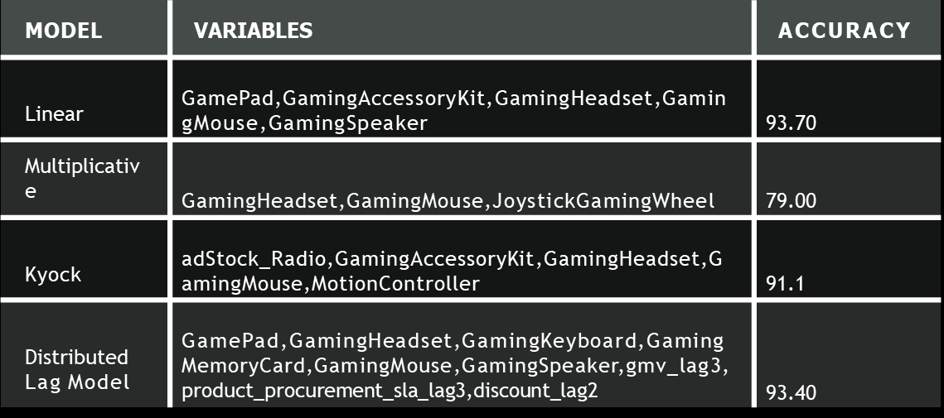
GAMING ACCESSORY MODELS

Slide 19
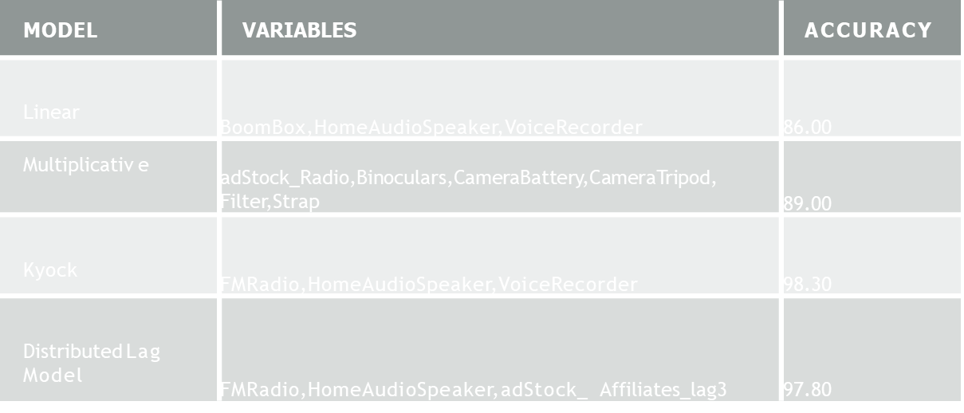
HOME AUDIO MODELS

Slide 20
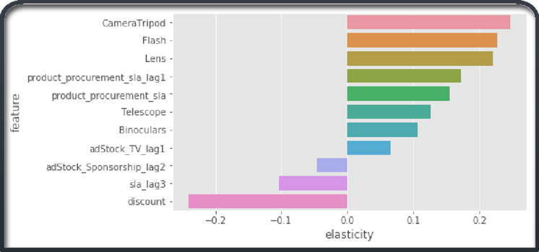
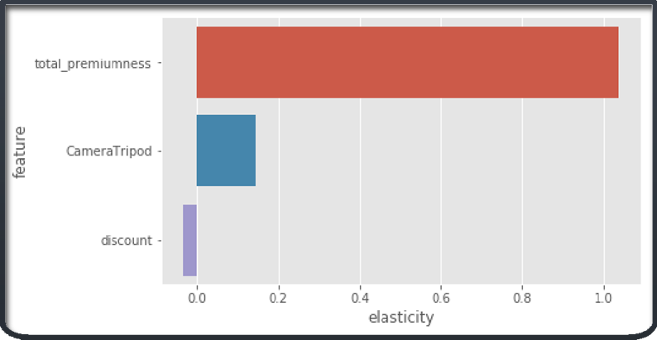
RECOMMENDATIONS FOR CAMERA ACCESSORY
Elasticity of distributed lag model
Since distributed lag and multiplicative models are the two finest models for camera accessories, we will base our recommendations on the model's variable elasticity.
Therefore, it makes sense to invest in TV channel marketing for the Camera Accessory category to boost sales of the tripod, flash, lens, telescope, and binocular categories.
Discounts ought to be cut. The promotion of high-end goods should receive more funding.
Elasticity of linear model

Slide 21
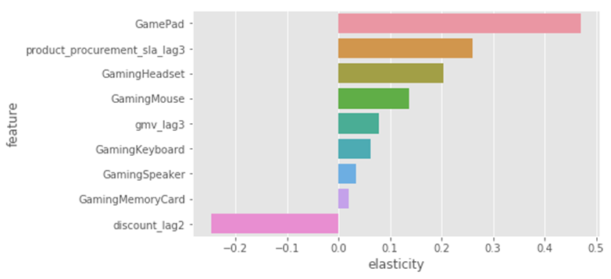
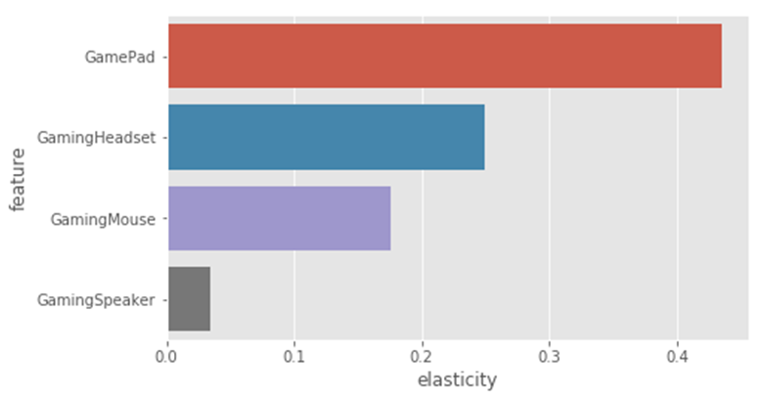
RECOMMENDATIONS FOR GAMING ACCESSORY
Elasticity of distributed lag model
The elasticity of the variables in this model will be used to provide suggestions, as the linear and distributed lag models are the two best models for gaming accessories.
Therefore, investing in marketing to try to boost sales of gaming headsets, gaming mice, and gaming pads is a smart strategy for the gaming accessory industry.
Reduce the discounts from the previous two weeks.
Elasticity of linear model

Slide 22
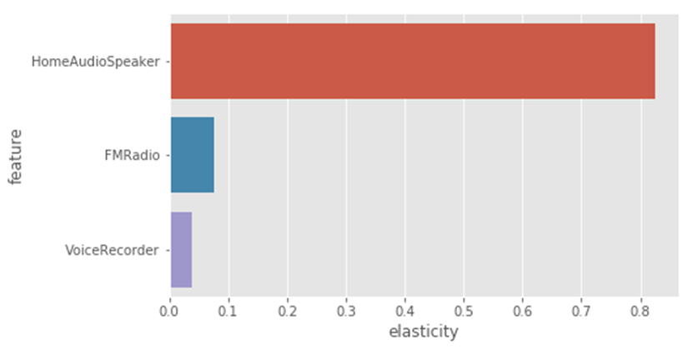
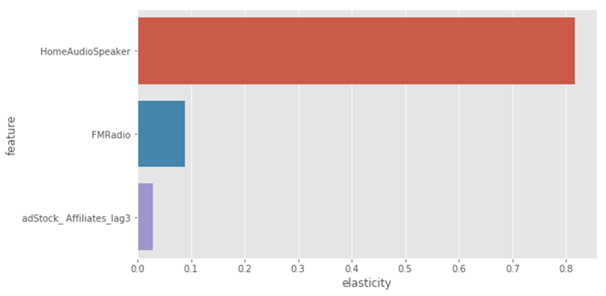
RECOMMENDATIONS FOR HOME AUDIO
Elasticity of Kyok model
The elasticity of the variables in this model will be used to provide suggestions, as the Kyok and distributed lag models are the two best models for home audio. Therefore, investing in marketing to try to boost sales of Boom Box and Home Audio Speaker products is a smart idea for the Home Audio sector. Affiliates and FM radio channel promotion should both receive resources.
Elasticity of distributed lag model

Slide 23
THANK YOU

